Slide 1


My Technical Life: A Retrospective View
C. Mohan
Distinguished Visiting Professor, Tsinghua University
Visiting Researcher, Google
Retired IBM Fellow, IBM Research Silicon Valley
Member Board of Governors, Digital University Kerala
https://bit.ly/CMoTalks https://bit.ly/CMoDUK
Pohang University of Science and Technology (POSTECH) Distinguished Seminar
Pohang, South Korea
9 November 2022
Slides https://bit.ly/CMPoRe

Slide 2
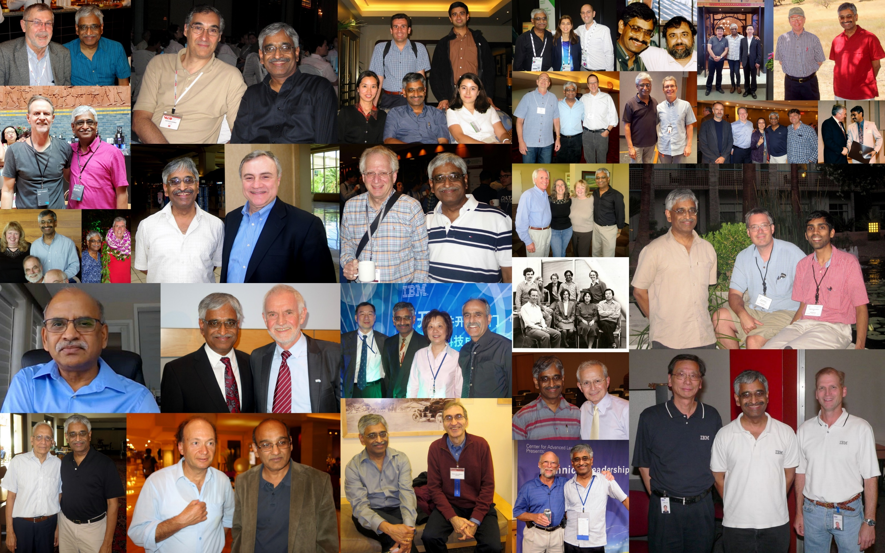
Collaborators and Promoters
Incomplete Set!

Slide 3
Caveats
Straight talk, no beating around the bush just to be diplomatic
I grew up in a different place and time
  US research environment inside and outside IBM
  Seen the good and the bad times at IBM
  Can straddle luxury and economy lifestyles
  67 years old, left India in 1977 and was in India 6/2006-1/2009
Lots of sacrifices on my part and more importantly my family’s part (11 years ex-IBMer wife, 32- & 28-year-old daughter and son)
Spent my entire career at IBM (38.5 years) as a non-manager, although an IBM exec for 23 years (Band D for 20.5 & C for 2.5) –
still have tried to look at things from a manager’s perspective
Cared a lot about my image inside and outside IBM
Your mileage might vary!

Slide 4
B.Tech. Days at IITM
Chemical Engineering student but known as “Computer” Mohan
In 2nd year (1973), IBM mainframe 370/155 arrived in IITM
Unlimited access to 370 for 4 years – all my spare time + more!
Computer Club, self study and a few unofficial M.Tech. CS classes
Played with many comp application packages –
Decision to do PhD in management science initially
After debugging a broken advanced feature in GPSS in summer of 1975, decided to do PhD in computer science in USA
Wrote papers for computer club magazine and CSI conferences
On mailing lists of dozens of CS departments in US Univs and industrial research labs – some Profs sent even recent PhD theses!
Deep interest in DBMS and OS topics – wrote survey papers
B.Tech. project work in CS rather than Chemical Engineering

Slide 5
Ph.D. Days at Univ of Texas at Austin
No assistantship before reaching Austin! Intent on US study!!
Within 10 days, got research assistantship
Finished Ph.D. qualifiers in 4 semesters, but difficulty in finding a thesis topic – changed advisors a few times
Finally, Avi Silberschatz & Don Fussell came to Austin in Fall 1980, became their student in Dec 1980
Finished Ph.D. in Dec 1981 on locking in database systems
Worked 2 summers in Europe
  1979 at INRIA Rocquencourt, Paris
  1980 at Hahn Meitner Institute, West Berlin
Published on different topics as a student, including a controversial, in-depth and very critical paper on SDD-1, a distributed DBMS by Computer Corporation of America (CCA)

Slide 6
Job at IBM Research, San Jose
On graduation, eager to get more practical work done
Decided not to apply for teaching positions
Interviewed at IBM Research Watson and San Jose, HP Labs, Bell Labs, CCA and Lawrence Berkeley National Lab (LBNL)
Joined IBM Research in San Jose in Dec 1981
Mecca of database research: Birthplace of relational DBs and SQL
R* distributed database project, follow on to System R –
essentially replacement for Jim Gray who left IBM in Fall 1980
Initial work on distributed transaction recovery – Presumed Abort
Became an int’l standard and used everywhere, lot of work much later to adapt to IBM network protocols (LU 6.2) to get into DB2 DRDA architecture
Didn’t need to be advised about technical careers, surrounded by people with distinguished research careers (Codd, Backus, Fagin, Pippenger, …)
Many IBM Fellows came out of R* later
Pat Selinger, Bruce Lindsay, C. Mohan, Hamid Pirahesh, Laura Haas

Slide 7
History of Work on ARIES Family of Algorithms
Late-70s' Sys R conclusion: Recovery with write-ahead logging (WAL) better than with shadow paging BUT Sys R's locking & recovery paradigms later heavily influenced R&D
Mid-80s: Basic locking and recovery work believed to be a dead research topic by general database community
After R* project at IBM Almaden, Starburst was initiated to design a new extensible and client-server DBMS
I, a non-System R person, decided to revisit System R legacy, despite counter advise from the “legacy” people
  Found major unsolved problems in the area of locking & recovery: Using WAL how to do efficient, fine granule locking with logical logging and flexible storage management
  Important Sys R algorithms left undocumented:
  index locking & recovery, partial rollback handling, ...
  Some significant original design flaws remained in product version of Sys R: e.g., space reservation

Slide 8
ARIES History
Dug up some old unpublished Sys R memos
Reverse engineered code of Sys R, SQL/DS, DB2/MVS, IMS: Many inventors were long gone from IBM, including Jim Gray
Consulted with developers of mainframe DB2 to learn why its recovery differed significantly from Sys R
Synergy from interactions between researchers and developers
Benefited from accumulated prototype/product history
Greater appreciation of customer problems with resulting algorithms being much more realistic
Evolutionary, rather than revolutionary, solutions –
very important for technology transfer
Resulted in formation of Data Base Technology Institute (DBTI) to encourage interactions between IBM Research and DBMS product groups: Huge success!

Slide 9
ARIES Impact
Numerous IBM products and prototypes
DB2 RDBMS workstation and mainframe versions
Starburst extensible DBMS
MQSeries/390 transactional messaging & queuing product
Lotus Domino/Notes
ADSM (TSM) backup and restore product on numerous platforms
Encina (Transarc) transaction monitor
QuickSilver distributed operating system

Slide 10
ARIES Impact
Other companies’ products
  Microsoft SQL Server and NT File System
  Sybase ASE
  O2 object-oriented DBMS
  Informix Cloudscape
Research impact and prototypes
  Huge number of citations by others to original ARIES paper
  Extensions, formalization of subsets, coverage in textbooks, ...
  Gamma database machine, Exodus extensible DBMS, Shore persistent object system, Paradise GIS
  Predator object-relational DBMS
  Odysseus DB-IR-Spatial Tightly-Integrated DBMS, KAIST, Korea
  Pjama - persistent Java

Slide 11
Challenges
Convincing research community about locking and recovery as important areas to do research in
Papers kept getting rejected – sheep mentality by research community about what is worthy of attention and what is cool!
Needed to evangelize a lot my work – mail papers, offer to give talks, spend time with faculty, students and industrial researchers
Did extensive groundwork on past approaches
Easy to do tech transfer into brand new product (OS/2 EE DBM: 1986-1988) than into an existing product (DB2 on mainframe: 1987-1994) – follow-through hard work to productize after initial research work highly appreciated by product teams and executives

Slide 12
Wider Cross Divisional IBM Impact
Word spread from Silicon Valley to NY area (Poughkeepsie)
  DB2 chief architect made me get involved with mainframe architects for shared disks support
  Major impact on Bipolar to CMOS chips transition via parallel sysplex coupling facility work
  Hardware architecture work + associated software changes to DB2
  One of 15 extraordinary Research accomplishments in 60 years of IBM Research history
From Silicon Valley to IBM UK (Hursley)
  DB2 chief architect made me get involved with mainframe messaging architects for file-based persistence support
  Changes to ARIES to accommodate MQSeries semantics
Silicon Valley to Boston area (Westford)
When rest of IBM desperately sought Lotus’ attention, they came to me for help because of my papers to add log-based recovery to Lotus Notes

Slide 13
Wider Cross Divisional IBM Impact
From Silicon Valley to Europe (Vienna & Boeblingen)
  Took the initiative on workflow management when FlowMark was being worked on and DEC was very active
  Lots of pain in getting even minimal funding – make do with postdocs and visiting profs in Exotica project
  Lots of papers but not enough acknowledged contributions to IBM products
From Silicon Valley to SVL and Raleigh
  Work on DBCache project
  Collaboration with WebSphere and DB2 LUW groups
  Not enough IBM product impact but some impact on research community

Slide 14
Subsequent Projects – Hit & Miss Impact Wise
DBMS Implications of Byte-Addressable NVM
DB2 BLU Column Store
IBM DB2 Analytics Appliance (IDAA): DB2 z + Netezza
Db2 Event Store (HTAP)
FabRDBMS (SQL support in Hyperledger Fabric blockchain system)
NVMe Storage + DBMS

Slide 15
Awards, Honors, …
1992: Member, IBM Academy of Technology
(3 years after AoT began)
1996: ACM SIGMOD Innovations Award
(first non-American; after Stonebraker, Gray, Bernstein, DeWitt)
1997: IBM Fellow (15 years after joining IBM), Master Inventor
1998: VLDB 10 Year Best Impact Paper Award (ARIES work)
2002: IEEE & ACM Fellow
2003: Distinguished Alumnus of IIT Madras
2009: US National Academy of Engineering (NAE) & Indian NAE
2016: Distinguished Visiting Professor, Tsinghua University
Numerous IBM Outstanding Innovation and Technical Achievement Awards, IBM Corporate Awards
Even though I have never been a manager, my 2nd line manager was the $100B revenue IBM’s CEO, Sam Palmisano for 6 months!!

Slide 16
Summary
In research, avoid tendency to "go with the flow"
Seek and tackle ignored problems
Focus more on practical AND intellectually challenging problems
Personally, benefited enormously from working for a company (IBM) with numerous transaction systems and great colleagues
Questioning senior colleagues' conclusions/advice and
perseverance are good attributes to have
Industry should publish more, even product developers
Be active outside your employer (e.g., ACM SIGMOD)
Even pure techies should have very good soft skills to have impact
Not enough to just do good work, even such work needs marketing
Learn to leverage others and be willing to share credit
Don’t be shy to complain! Squeaky wheel gets the grease!!
Don’t look for quick return on investment
With papers, don’t lose sight of quality in the interest of quantity
Important to stick your neck out and get out of your comfort zone

Slide 17
Biodata Post-IBM
Dr. C. Mohan is currently a Visiting Researcher at Google, Distinguished Visiting Professor at Tsinghua University in China, a Member of the inaugural Board of Governors of Digital University Kerala, and an Advisor of the Kerala Blockchain Academy (KBA) and the Tamil Nadu e-Governance Agency (TNeGA) in India. He retired in June 2020 from being an IBM Fellow at the IBM Almaden Research Center in Silicon Valley. He was an IBM researcher for 38.5 years in the database, blockchain, AI and related areas, impacting numerous IBM and non-IBM products, the research and academic communities, and standards, especially with his invention of the well-known ARIES family of database locking and recovery algorithms, and the Presumed Abort distributed commit protocol. This IBM (1997-2020), ACM (2002) and IEEE (2002) Fellow has also served as the IBM India Chief Scientist (2006-2009). In addition to receiving the ACM SIGMOD Edgar F. Codd Innovations Award (1996), the VLDB 10 Year Best Paper Award (1999) and numerous IBM awards, Mohan was elected to the US and Indian National Academies of Engineering (2009) and named an IBM Master Inventor (1997). This Distinguished Alumnus of IIT Madras (1977) received his PhD at the University of Texas at Austin (1981). He is an inventor of 50 patents. During the last many years, he focused on Blockchain, AI, Big Data and Cloud Database technologies (https://bit.ly/CMoTalks). Since 2017, he has been an evangelist of permissioned blockchains and the myth buster of permissionless blockchains. During 1H2021, Mohan was the Shaw Visiting Professor at the National University of Singapore where he taught a seminar course on distributed data and computing. In late 2019, he became an Honorary Advisor to TNeGA for its blockchain and other projects. In August 2020, he joined the Advisory Board of KBA of India. Since 2016, Mohan has been a Distinguished Visiting Professor of China’s prestigious Tsinghua University. In September 2021, he was inducted as a member of the inaugural Board of Governors of the new Indian university Digital University Kerala. He has served on the advisory board of IEEE Spectrum, and on numerous conference and journal boards. He has also been a Consultant to the Microsoft Data Team. Mohan is a frequent speaker in North America, Europe and Asia. He has given talks in 43 countries. He is highly active on social media and has a huge network of followers. More information can be found in the Wikipedia page at https://bit.ly/CMwIkP and his home page at https://bit.ly/CMoDUK

Slide 18
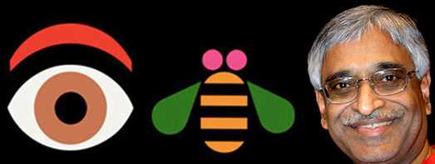
June 2020 Parting Message After 38.5 Years
Goodbye IBM!
Will miss the people & the company ☺

Slide 19
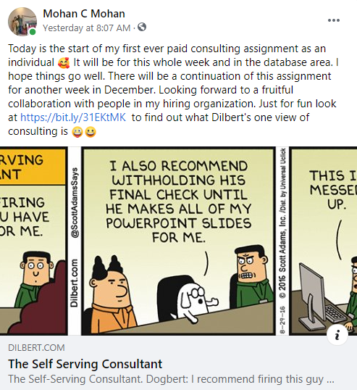
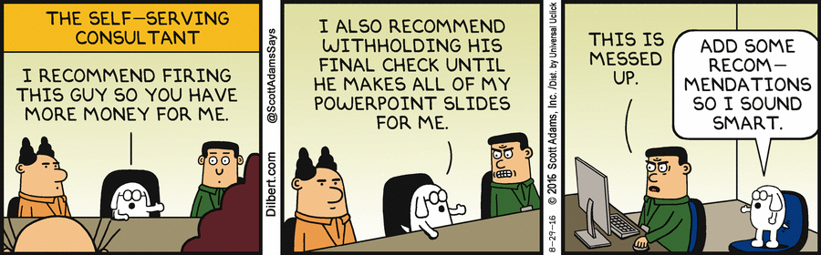
Social Media Post: Just Before Consulting Began

Slide 20
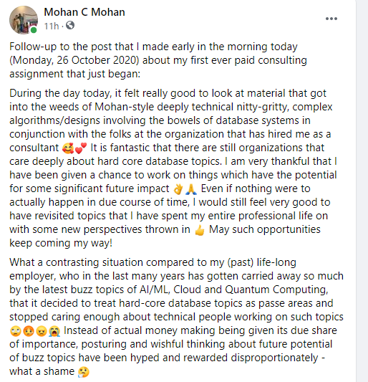
Social Media Post: End of 1st Consulting Day @ MS

Slide 21
Post-Retirement Technical + Other Work
Consulting for Google since March 2022
Consulted for Microsoft’s Azure SQL team
Numerous talks in many countries (virtual/in-person/hybrid)
  AI
  Blockchain
  Cloud Databases & Query Processing
  Technical careers
Serving as advisor
  Tamil Nadu e-Governance Agency (TNeGA), especially for its Nambikkai Inaiyam blockchain backbone project
  Kerala Blockchain Academy (KBA)
Deep engagement in the affairs of the new Digital University Kerala (DUK) as a Member of its inaugural Board of Governors
Shaw Visiting Professor at National University of Singapore (NUS) for 6 months teaching a seminar course (1H2021)
Industry Track Co-Chair for VLDB 2022 (Sydney, Australia)

