Slide 1


Founders and Pioneers Keynote
13th International Workshop on Self-Managing Database Systems (SMDB 2022)
Kuala Lumpur, Malaysia, 9 May 2022
Modern Cloud DBMSs Vindicate Age-Old Work on Shared Disks DBMSs
C. Mohan
Distinguished Visiting Professor (Tsinghua University, Beijing, China)
Visiting Researcher (Google, USA)
Member, Board of Governors (Digital University Kerala, India)
Retired IBM Fellow (Silicon Valley, USA) & Former Shaw Visiting Professor (National Univ of Singapore)
https://bit.ly/CMoDUK
Slides: https://bit.ly/KLsmPP
Video: https://bit.ly/SMDBvi

Slide 2
Indian Institute of Science (IISc)
Bangalore, India, 5 January 2022
A Survey of Cloud Database Systems
C. Mohan
Distinguished Visiting Professor (Tsinghua University, Beijing, China)
Member, Board of Governors (Digital University Kerala, India)
Retired IBM Fellow (Silicon Valley, USA) & Former Shaw Visiting Professor (National Univ of Singapore)
https://bit.ly/CMoDUK

Slide 3
Acks + More Info
Lots of material in this presentation picked was up from other sources
Will add later complete source references
https://bit.ly/CMnusC - Check out reading list for my National University of Singapore (NUS) seminar course (CS6282 Practical Cloud/Parallel/Distributed Data and Computing Systems) I taught in 1H2021
This presentation is still very much a work-in-progress and hence incomplete!
  Will be revising it significantly as I give it elsewhere
  Watch out for my social media posts on revised slides + videos
  Links to my social media accounts at https://bit.ly/CMoDUK

Slide 4
Relational Database Management Systems (RDBMSs)
My former IBM Research colleague in San Jose (California) Edgar F. Codd developed the relational model of data and the theory behind it before start of my IBM career
Other former colleagues then developed System R which gave rise to SQL language for data definition and data manipulation in a high-level, declarative manner
In parallel, in Univ of California at Berkely, Mike Stonebraker and colleagues developed Ingres and the language Quel which differed from SQL
SQL won the standardization game making IBMers very happy!
Very early on, Codd received the Turing Award for his relational data model work
Another former IBMer, Jim Gray, also got Turing Award for his transaction and other work
Much later, Mike Stonebraker got the same award for his RDBMS and related work
RDBMSs and SQL have stood the test of time, in spite of emergence of NoSQL, and big data systems like Hadoop and Spark

Slide 5
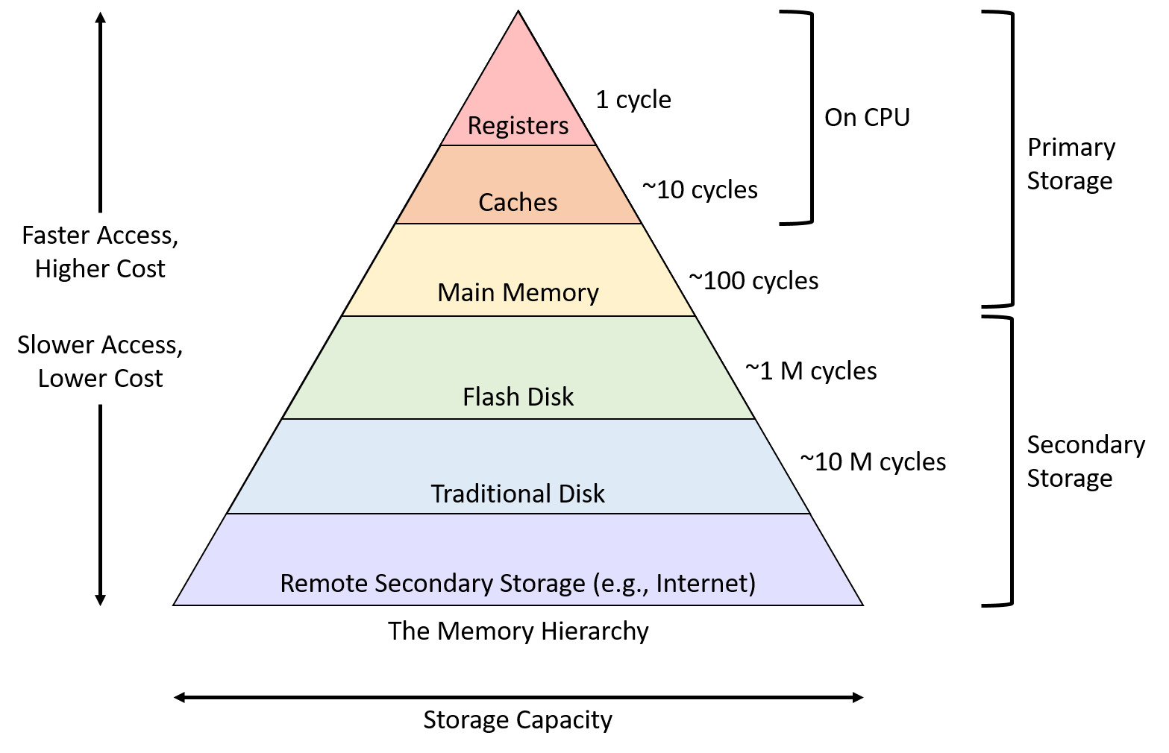
Storage Hierarchy
Source: https://diveintosystems.org/book/C11-MemHierarchy/mem_hierarchy.html

Slide 6
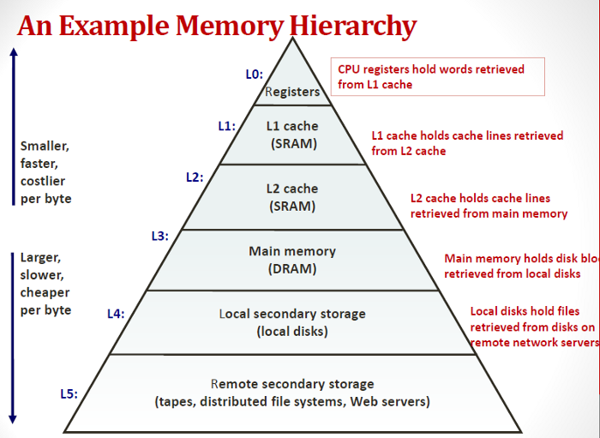
Storage Hierarchy
Source: https://medium.com/@esmerycornielle/the-cpu-and-the-memory-2eb300d6c72d

Slide 7
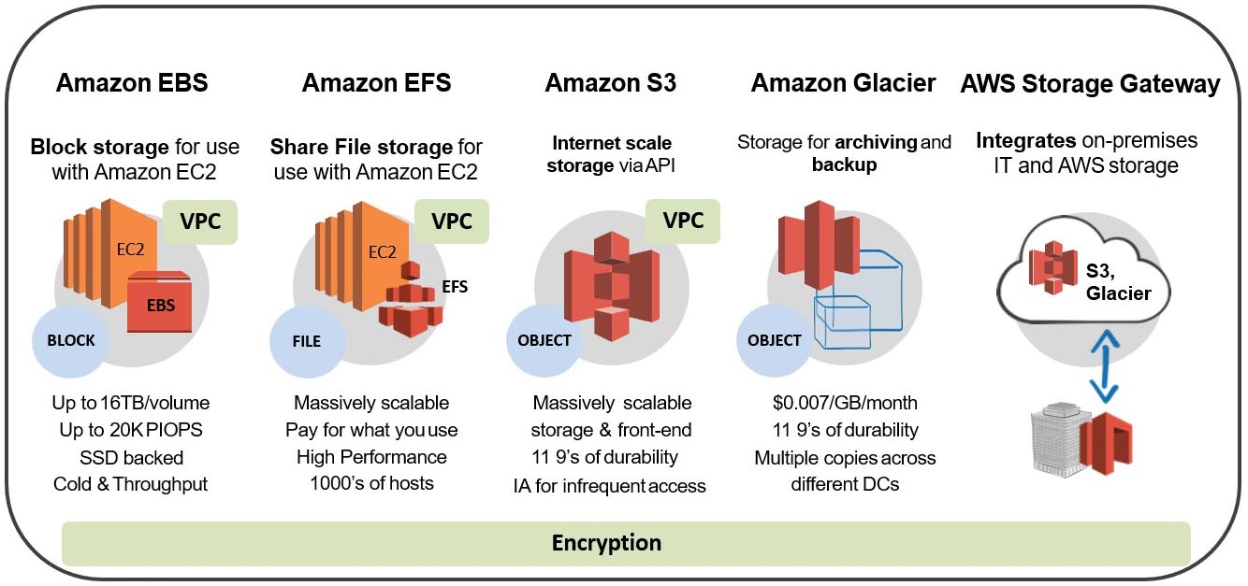
Storage Hierarchy
Source: https://proactive.co.in/aws-storage-solutions/

Slide 8
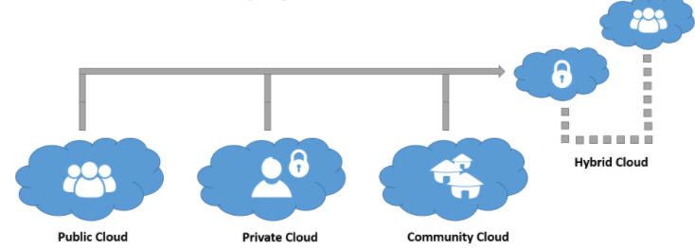
Cloud Deployment Models
Source: https://bit.ly/31KGP7j, 3/2017

Slide 9
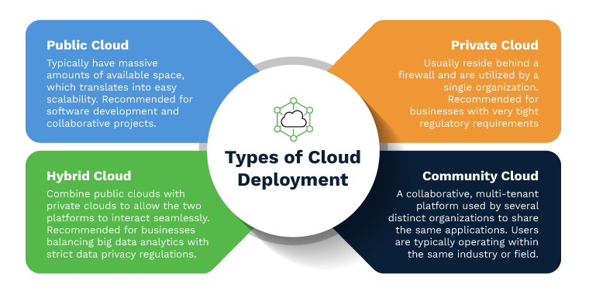
Cloud Deployment Models
Source: https://bit.ly/3rRGjPz, 2/2021

Slide 10
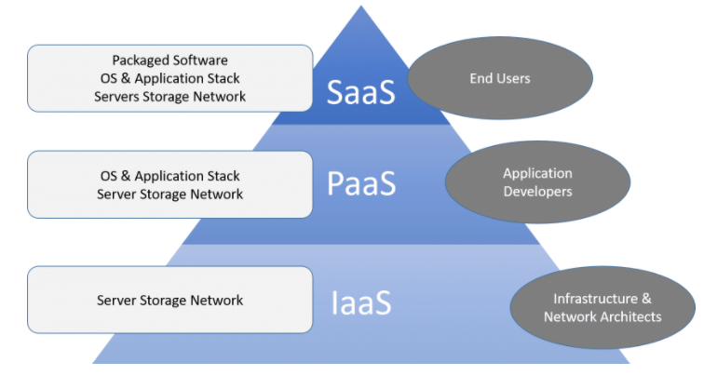
Cloud Service Models
Source: https://bit.ly/31KGP7j, 3/2017

Slide 11
Cloud Service Models
Infrastructure as a Service (IaaS): Virtualized resources
Microsoft Azure, Amazon Web Services (AWS), Cisco Metacloud, Google Compute Engine (GCE)
Platform as a Service (PaaS): IaaS + OS + Middleware
AWS Elastic Beanstalk, Apache Stratos, Google App Engine, Microsoft Azure
Software as a Service (SaaS): Fully developed software solution
Microsoft Office 365, Salesforce, Cisco WebEx, Google Apps
Function as a Service (FaaS): aka Serverless Computing – deploy application code
AWS Lambdas, Azure Functions
Source: https://bit.ly/3rRGjPz, 2/2021

Slide 12
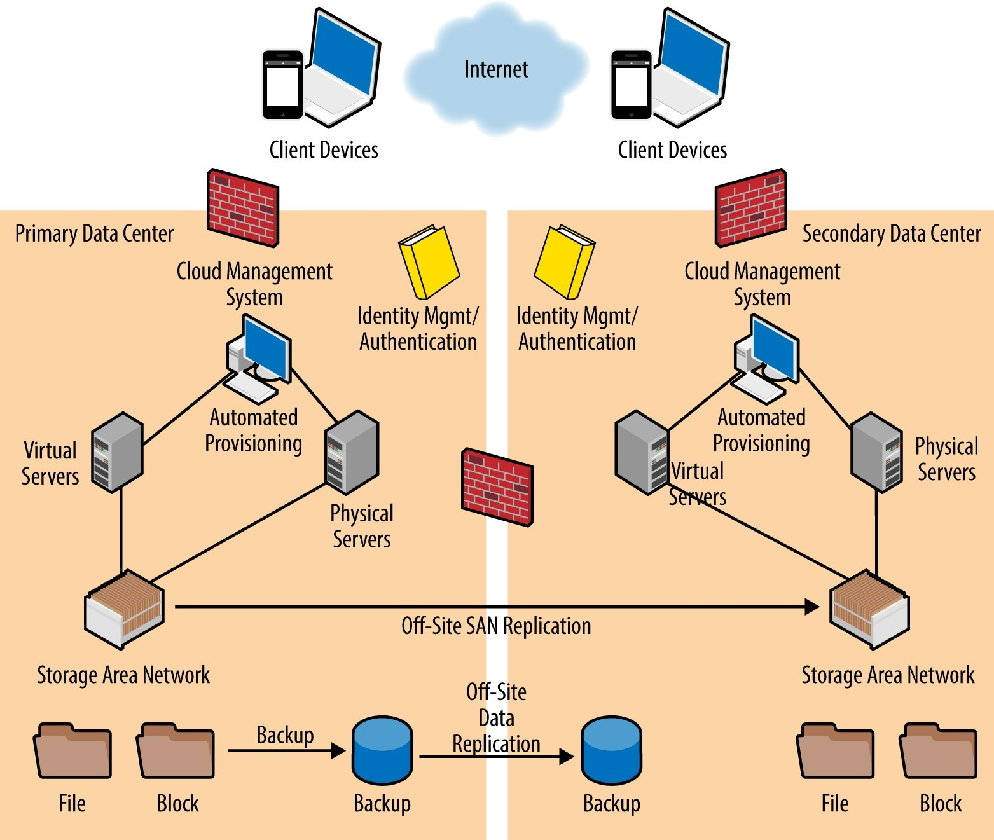
Cloud Data Center Architecture
Source: https://crmtrilogix.com/Cloud-Blog/IaaS-and-PaaS/Cloud-Infrastructure--Data-Center-Architecture/160

Slide 13
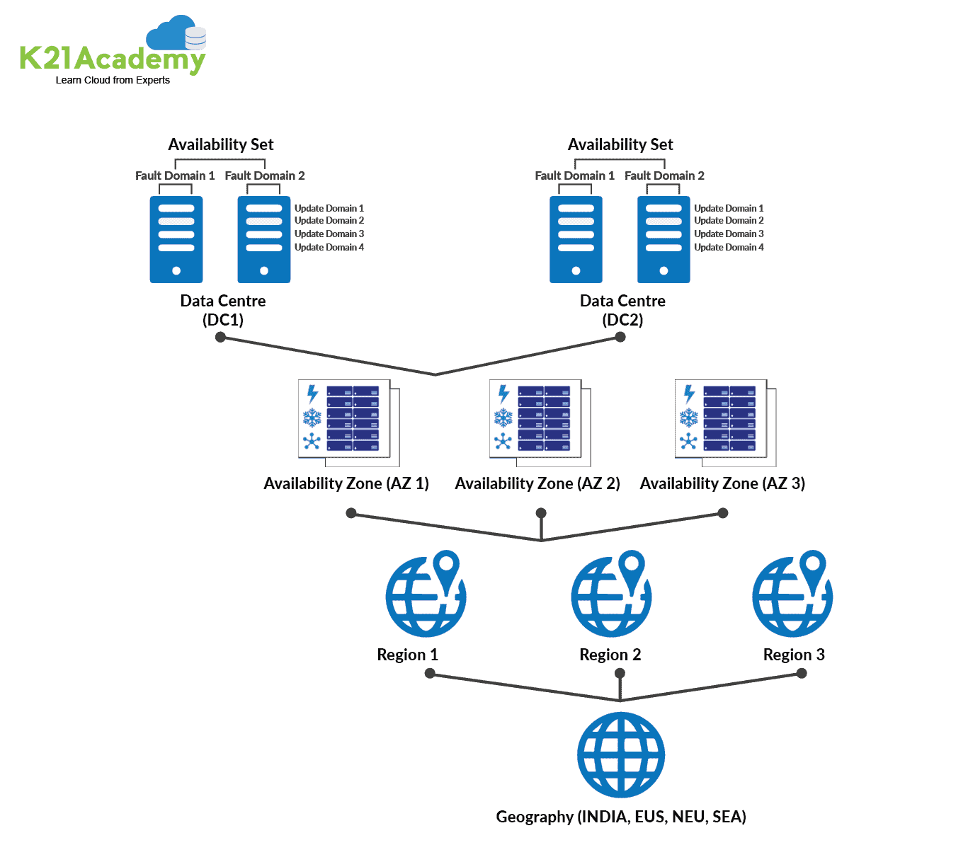
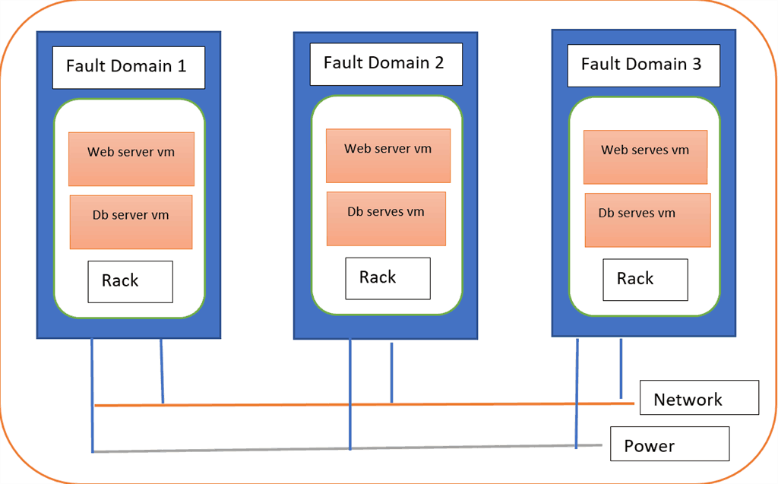
Cloud Fault Domain Zones Regions
Source: https://k21academy.com/microsoft-azure/az-303/azure-availability-zones-and-regions/

Slide 14
Different Workloads
Online Transaction Processing (OLTP)
Online Analytical Processing (OLAP)
Modern Application Requirements
Design Challenges of HTAP Systems
HTAP/OLTAP Systems
  IBM DB2 BLU and IBM Wildfire/Db2 Event Store
  MemSQL (SingleStore)
  Oracle DBIM
  SAP HANA
  VoltDB
  HyPer
  TiDB

Slide 15
Online Transaction Processing (OLTP)
Online Transaction Processing (OLTP) systems around for 4 decades: TPF, IMS, CICS …
Much later RDBMSs … DB2, Oracle, Sybase, Informix, …
Focus on short transactions (both reads and writes), typically not ad-hoc
Major emphasis on failure tolerance, performance (response time & throughput), security, priority-based scheduling, …
Various benchmarks have driven developments: Transaction Processing Council (TPC):
B, C, E, … http://tpc.org/information/benchmarks5.asp
Prolonged debate on system architectures: Shared Everything (SE), Shared Disks (SD), Shared Nothing (SN) – SD has won (DB2, Oracle)
Indexing has been crucial – typically, B+ trees but also hashing in some systems
Stored procedures used for high performance
Of late, leveraging main memory, SSD; compiling to machine code; …

Slide 16
Online Analytical Processing (OLAP)
Complex high-level queries for decision support, data mining, multi-dimensional analytics with data warehouses
Consolidation (roll-up), drill-down, and slicing and dicing
Ad hoc or repetitive long-running queries needing complex query optimization techniques
Indexing choices harder due to ad hoc nature of queries + maintenance cost
Precomputed views might be used
TPC DI, DS, H, x-HS, … benchmarks http://tpc.org/information/benchmarks5.asp
Periodic replication from OLTP systems, reduced data currency: delayed analytics
Parallel RDBMSs – DB2, Teradata, Netezza, Vertica, VectorWise
MOLAP, ROLAP, Hybrid systems – Hyperion, Essbase, Cognos, Business Objects, Microsoft Analysis Services, …
Modern ones are column stores, Hadoop systems; leverage GPUs, FPGAs, …

Slide 17
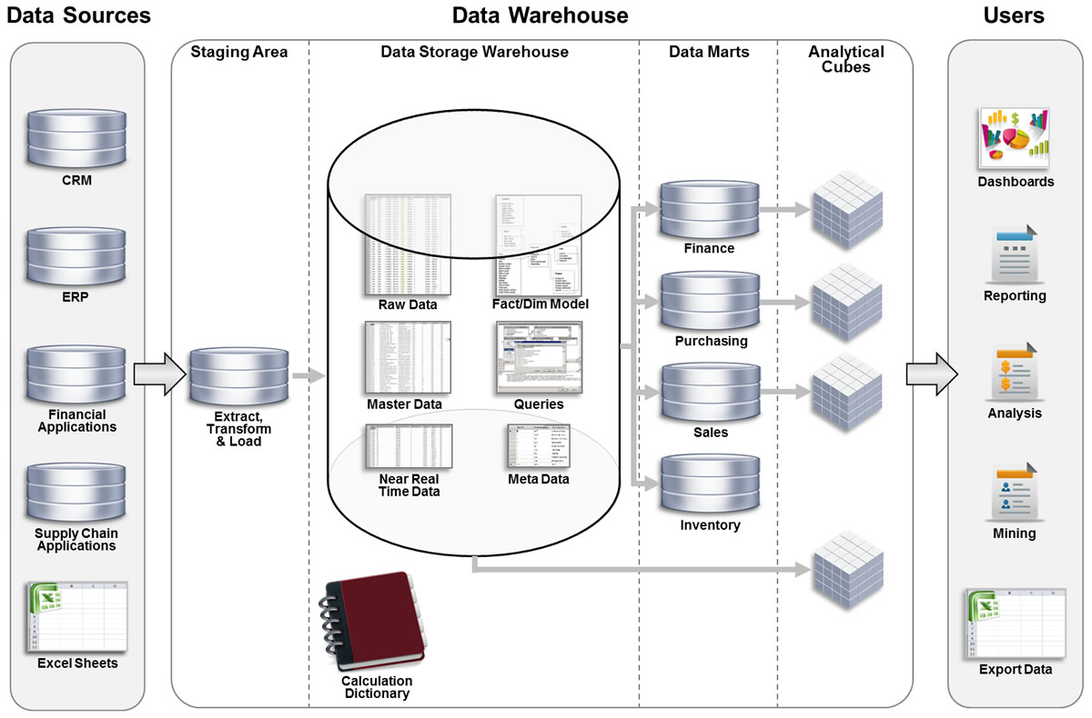
Data Warehouse Architecture

Slide 18
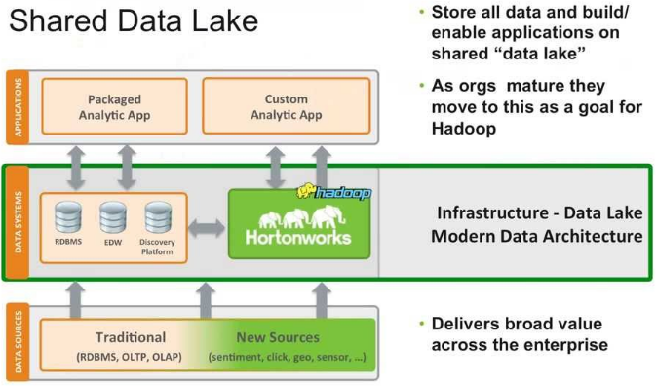
Modern Data Architecture

Slide 19
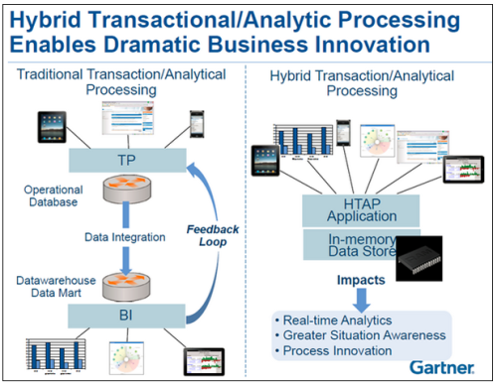
HTAP Benefits

Slide 20
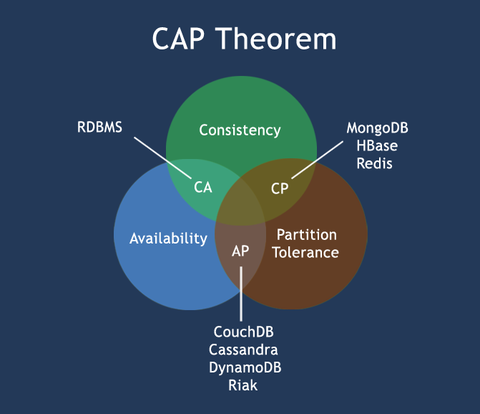
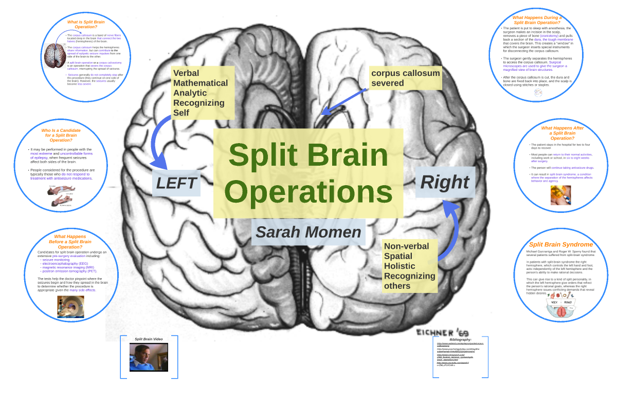
Tradeoffs in the New Age
“Split-Brain” Syndrome
http://www.w3resource.com/mongodb/nosql.php

Slide 21
Modern Application Requirements
Real-time operational intelligence processing
In rapidly changing databases, analytics on latest states of data
Hybrid Transactional/Analytics Processing (HTAP) processing on same data with stringent response time and data currency requirements
Eliminate multiple copies of data
High volume of transactions, high ingest rate streaming of data
Ads/recommendation serving in mobile environments
Sensors at the edge of the network (a la Apache Edgent)
Public safety, risk management, fraud detection, real-time inventory/pricing, …
High availability in highly distributed environments with high rate of failures of different components
Stronger transactional guarantees than what NoSQL systems give

Slide 22
Modern DBMSs: Design Challenges
Row/Columnar formats
Logging, buffer hits and row reconstruction overheads to columnar format
I/O overheads, compression inefficiencies of row format
In-place updates versus versioning: append-only versus true update workloads
Index maintenance overheads of versioning data
Strict consistency versus conflicting updates: a function of need for multi-data center configurations (globally distributed operations versus only localized operations)
Additional complications of public cloud
Scaling challenges with addition and deletion of nodes
Pains stemming from “brain-dead” but currently very popular file systems like HDFS!
Supporting recent as well as historical data

Slide 23
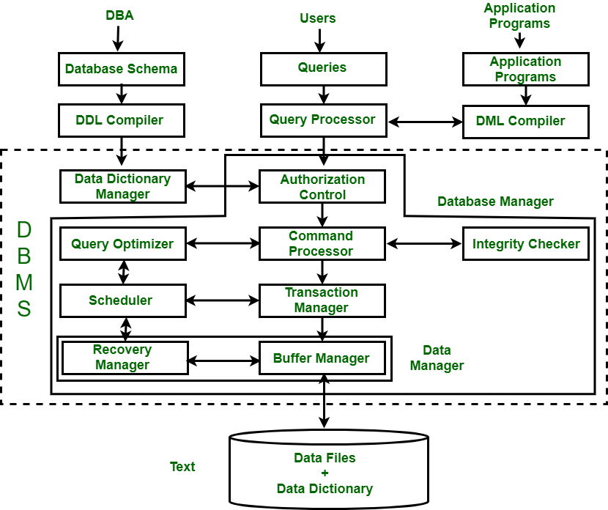
Traditional DBMS Architecture
Source: https://www.geeksforgeeks.org/structure-of-database-management-system/

Slide 24
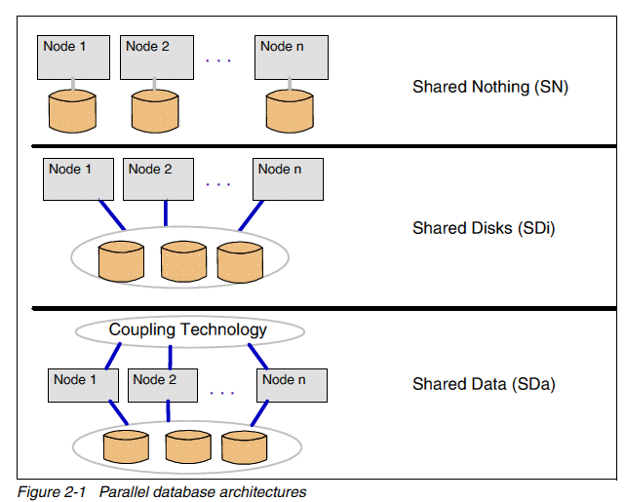
Traditional Parallel Database Architectures
Source: DB2 for z/OS: Data Sharing in a Nutshell, IBM Redbook SG24-7322-00, October 2006

Slide 25
History & Features of SD DBMSs
Decades-old technology: IBM IMS, DEC Rdb, Oracle OPS/RAC, IBM Parallel Sysplex DB2 Z & later DB2 LUW, Japanese Computer Companies
I worked on it in late 1980s & 1990s! 2-way R-W sharing in IMS in 1980s
DBMS researchers like Gray, DeWitt, … not in favor of it –
preferred SN systems like Teradata, Tandem Nonstop SQL, …
SD Features
Global & Hierarchical locking
Lock caching and retention
Buffer coherency across N-way R-W sharing nodes
Efficient inter-node page transfers
Single node recovery & Multi-node recovery
Source: https://bit.ly/RepHis, IBM

Slide 26
Traditional Distributed Databases
Have been worked on for 5 decades
My first project at IBM Research in 1982 was R*, the distributed version of System R
  Invented two-phase commit variations like Presumed Abort (PA) and Presumed Commit (PC)
  Distributed query processing and optimization
  Snapshots – aka materialized views in a distributed context
Replication – synchronous, asynchronous
Evolution from homogeneous database nodes to heterogeneous nodes – heterogeneous databases – global and local optimizations
Data partitioning – horizontal and vertical
Failure models – Byzantine failures included or not
Node autonomy considerations

Slide 27
Traditional Database Replication
Primary log replay at replica – homogeneous systems with full DB replicas, typically done for disaster recovery (DR) backup
Log capture generates DML statements from what is logged and apply executes those statements (e.g., IBM Q Replication)
  Can handle non-determinism and partial replicas
  Requires dependency analysis to leverage parallelism at apply time
  https://www.ibm.com/developerworks/data/roadmaps/qrepl-roadmap.html
Capture DML statements as issued by application and re-execute them at replica (e.g., H-Store/VoltDB)
  Cannot handle non-determinism
  Typically, serial execution of transactions

Slide 28
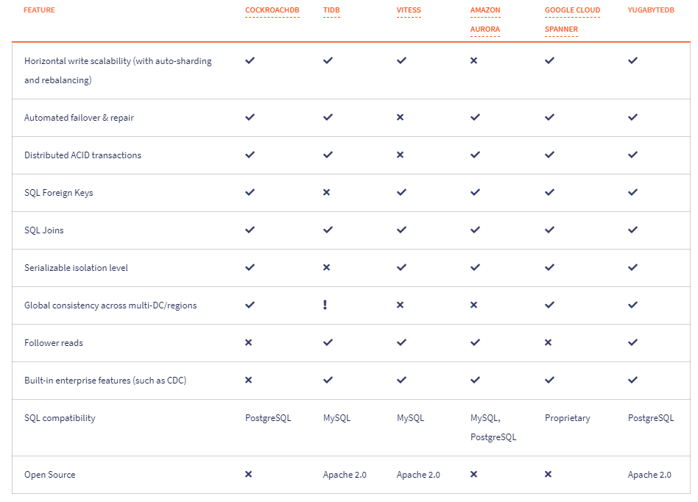
Distributed SQL Databases Comparison
Source: http://bit.ly/3t3rBDa Yugabyte, 1/2021

Slide 29
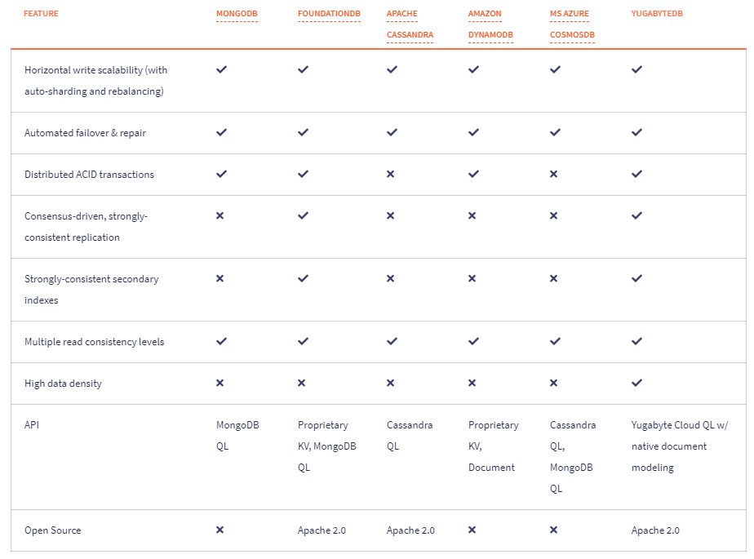
Distributed NoSQL Databases Comparison
Source: http://bit.ly/3t3rBDa Yugabyte, 1/2021

Slide 30
Seattle 2018 DB Meeting (http://bit.ly/DBseat)
Material from Working Group Report on Cloud Data Services
Chairs: Sailesh Krishnamurthy and Fatma Ozcan
Multitenancy
Serverless, PaaS, auto-scaling
  Serverless: Allows one to code without thinking about hardware/network configuration
Hybrid cloud
Implications of cloud for database engine architectures (DBaaS)
Auto-tuning and usability
Open source: Lack of a good open source distributed OLTP DBMS
Migrating apps from on-prem to cloud easily
Data sovereignty
What happens when storage/memory hierarchy becomes deep?
{block storage - object storage (S3) - cold storage (glacier) }

Slide 31
What Users Want
Performance and predictable costs without complex knobs or complicated system sizing
Pay-per-use pricing models as opposed to pricing based on pre-provisioned limits
Auto-scaling service capacity based on dynamic needs
Supporting multitenant SaaS applications
State management for new idioms like Serverless and Functions-as-a-Service
Applications that operate across multiple nodes, multiple datacenters (regionalized), multiple regions (globalized)
Applications that operate across on-premise and multiple cloud services seamlessly (hybrid cloud)

Slide 32
What Users Want
How can we use more ML/DL for auto-tuning cloud data services to eliminate DBAs? Optimal data layout (sharding and partitioning decisions), data caching decisions (where and which data to cache), better query optimization, admission control, etc.
Is there a way to determine when it is beneficial to move to the cloud?
There is a distinction between cost of services vs cost to operate.
Is this about cost of ownership, cost of startup, cost of burstiness/elasticity?
How can we run analytics workloads across data centers? How about active-active OLTP across data centers? Can we also enable HTAP?
How do disaggregated storage and a rich storage hierarchy (including NVRAM) impact cloud data architecture?

Slide 33
Some Cloud DBMSs
Alibaba POLARDB & POLARDB-X
Amazon Aurora
CockroachDB (CRDB)
FoundationDB
Google Spanner & F1
MariaDB
MongoDB
Snowflake
SQL DB Hyperscale (aka Microsoft Socrates) & POLARIS
YugabyteDB

Slide 34
Traditional vs Cloud DB Architectures
Compute
Compute
SQL
SQL
Compute and Storage
decoupled for scalability,
availability, durability
Transactions
Transactions
Caching
Caching
Logging
Logging
Local
Storage
Attached
Storage
Network
Storage

Slide 35
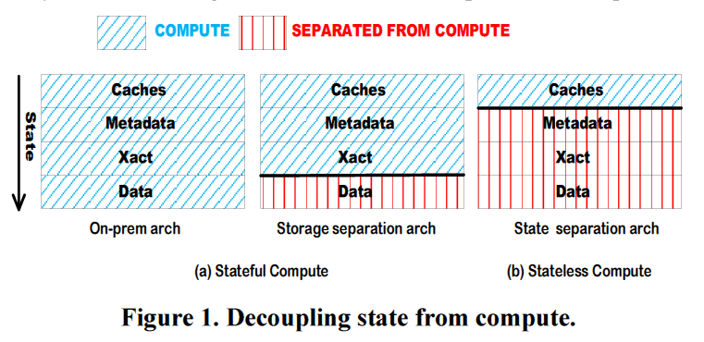
State Separation from Compute

Slide 36
Aurora Serverless
APPLICATION
Starts up on demand,
shuts down when not in use
Scales up/down automatically
Pay per second
REQUEST ROUTERS
WARM POOL
OF INSTANCES
SCALABLE DB CAPACITY
DATABASE STORAGE
Aurora MySQL launched in Oct 2014; Aurora Postgres launched in Oct 2017
Aurora received ACM SIGMOD Systems Award July 2019
Notes:
Most cloud-first feature of Aurora

Slide 37
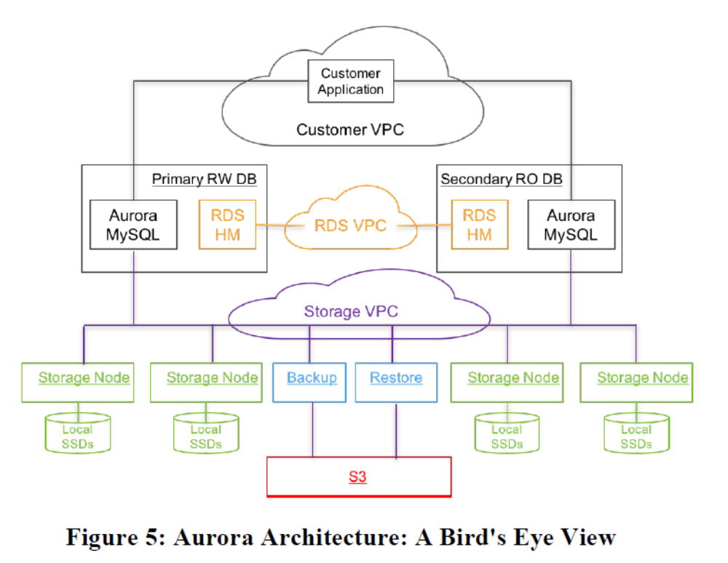
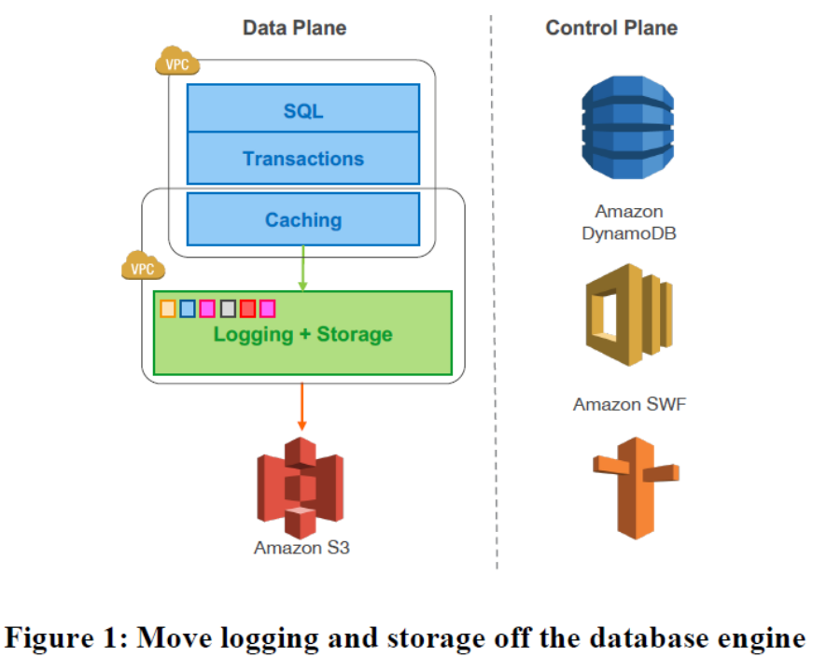
Amazon Aurora Design Philosophy
Source: https://bit.ly/3sl4fKz, AWS

Slide 38
Aurora Compute
Customer VPC
Single tenant compute instance (Head Node)
Handles upper half of database stack
  Client connection management
  Query processing
  Transaction management
  Locking
  Buffer cache
  Access methods
  Undo management
Customer
Application
Head Node
SQL
Transactions
Caching
Logging
Notes:
Responsible for full compatibility down to wire protocol

Slide 39
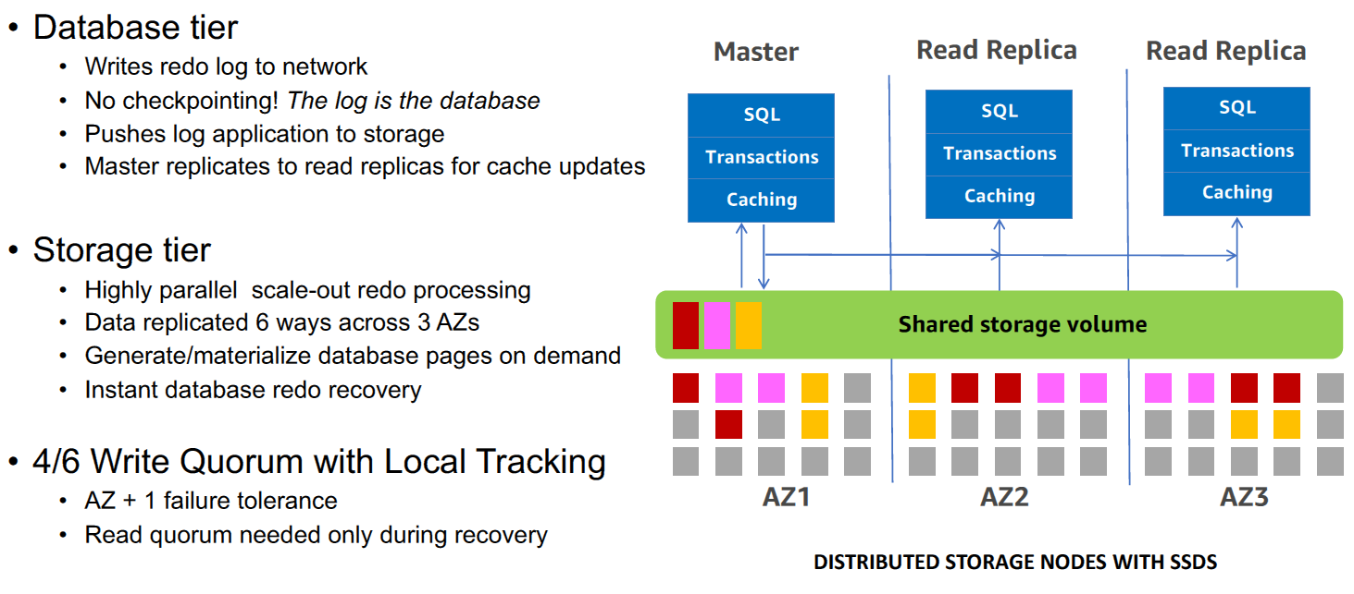
Aurora Architecture
Source: https://bit.ly/38eEapF, AWS

Slide 40
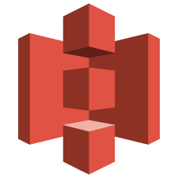
Aurora: Offload Redo to Storage
Database Tier
Writes redo log records on network
No full data block writes for checkpointing, cache eviction, background writes
Push log applicator to storage
Storage Tier
Multi tenant, scalable, replicated and self healing storage fleet
Each segment replicated 6 ways across 3 datacenters (AZs)
Highly parallel scale out redo processing
Generate DB blocks on demand (redo)
Materialize DB blocks in background (redo)
AZ 1
AZ 2
AZ 3
SQL
Transactions
Caching
Amazon S3
The Log is the Database

Slide 41
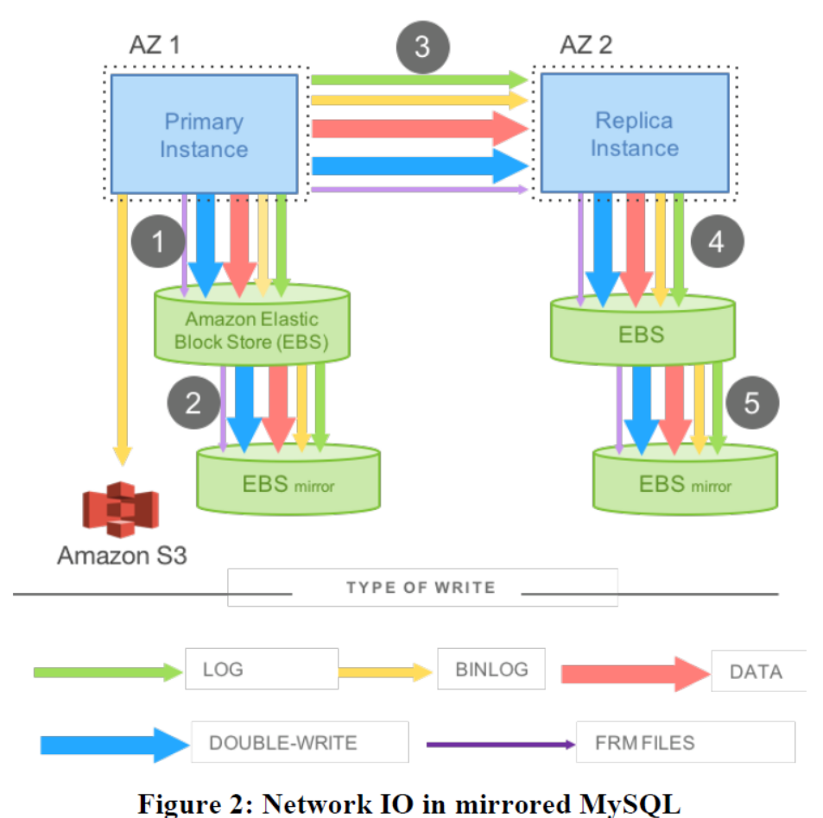
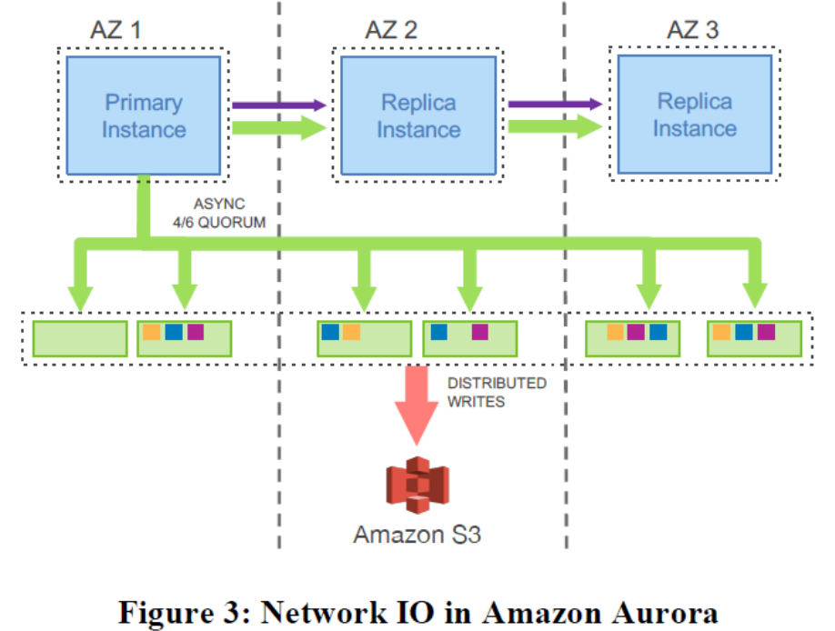
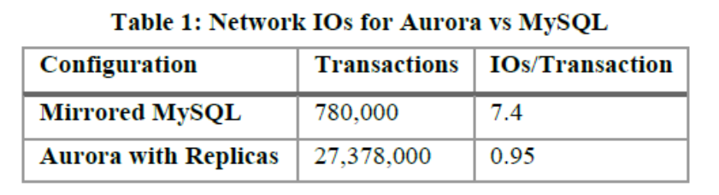
Network I/O in MySQL vs Amazon Aurora

Slide 42
Aurora Reduces Aggregate I/O Burden
30 minute SysBench write-only workload, 100GB dataset
RDS MySQL Multi-AZ 30K PIOPS
Total trx : 780K
I/Os per trx : 7.4 (ex-mirroring)
Aurora
Total trx : 27,378K
I/Os per trx : 0.95 (inc 6x amp)
35X MORE
7.7X LESS
6X more log writes, but 9X less network traffic

Slide 43
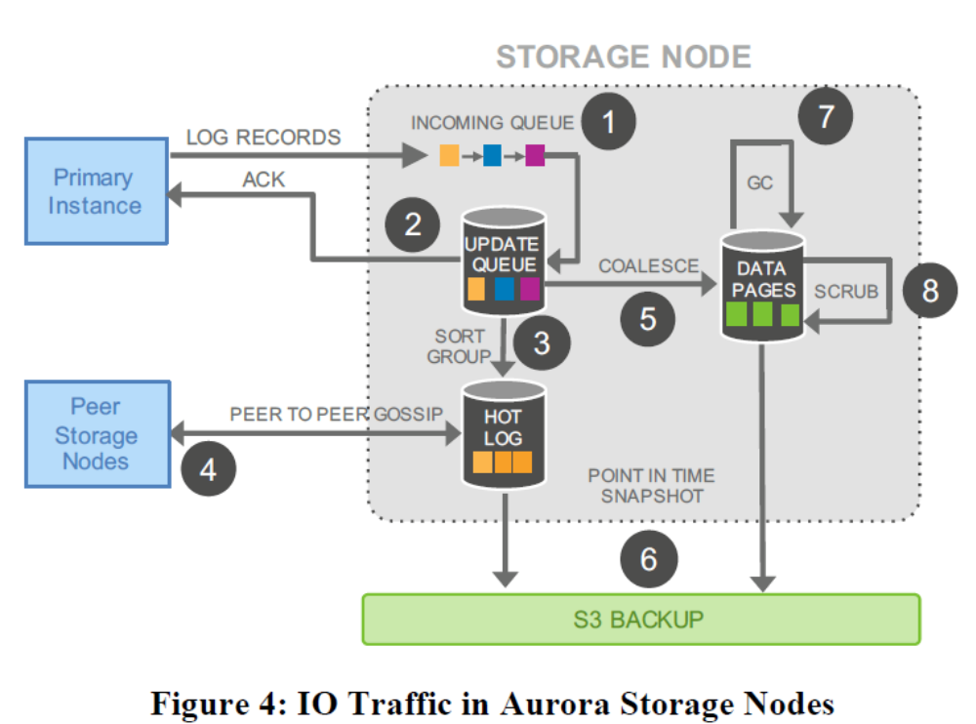
Aurora Storage Node
Source: https://bit.ly/3yrqnGW, AWS

Slide 44
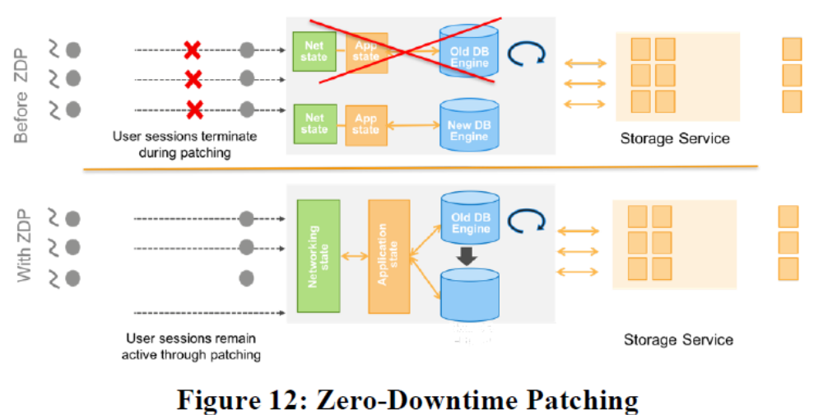
Availability & Software Upgrades

Slide 45
Distributed Commits in Cloud Databases
    No atomic flush spanning multiple storage nodes
    Commits over distributed storage use 2PC/Paxos to establish global consistency
    Network chatter leads to stalls and jitter in the write path
Compute
SQL
Transactions
Caching
Logging
Local
Storage
Network
Storage

Slide 46
Aurora: Asynchronous Commit Processing
    Storage nodes
      Establish compact consistency points that:
        Increase monotonically
        Are continuously returned to the database
      Do not vote on accepting a write
      Execute idempotent operations on local state
    Database nodes
      Handle locking, transactions, deadlocks, constraints etc.

Slide 47
Backward Chaining of Redo Log Records
    Each redo log record includes backlink LSNs:
      Block backlink: Previous log record of the modified block
        Used to materialize blocks on demand and background
      Segment backlink: Previous log record in the segment
        Used to identify records not received by the storage node
      Volume backlink: Previous log record in the volume
        Used to regenerate metadata as a fallback path

Slide 48
Aurora: Crash Recovery
DB opens all storage nodes, reach read quorum for all PGs
Locally re-compute PGCLs and VCL
VCL is the highest point where all records have met quorum
Everything past VCL is truncated at crash recovery
No redo or undo processing is required before the database is opened for processing
Ragged edge of log not meeting quorum and truncated at recovery
AT CRASH
Log records
Gaps
CRASH
Volume Complete
LSN (VCL)
IMMEDIATELY AFTER CRASH RECOVERY

Slide 49
Aurora Parallel Query
Database Node
Offload processing to storage
Designed for analytical queries
with large scans
Aurora storage has thousands of CPUs
Push down predicates
and parallelize query processing
Reduce network traffic
Avoid buffer pool trashing
Aggregate
results
Push down
predicates
Storage nodes
Notes:
Discuss a couple of features launched after paper; Leverage aurora storage for reads as well

Slide 50
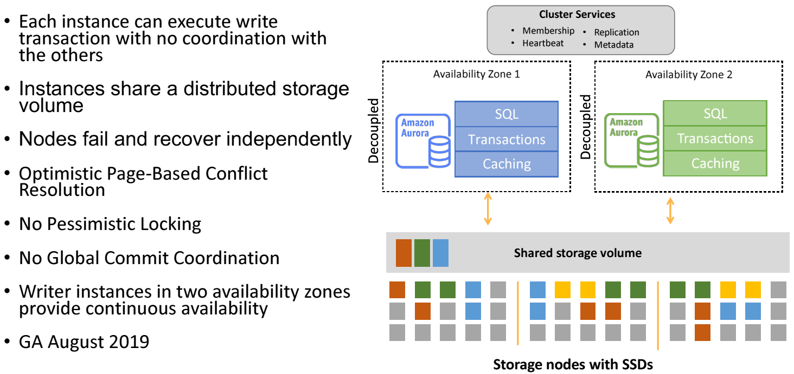
Aurora Multi-Master
Source: https://bit.ly/38eEapF, AWS

Slide 51
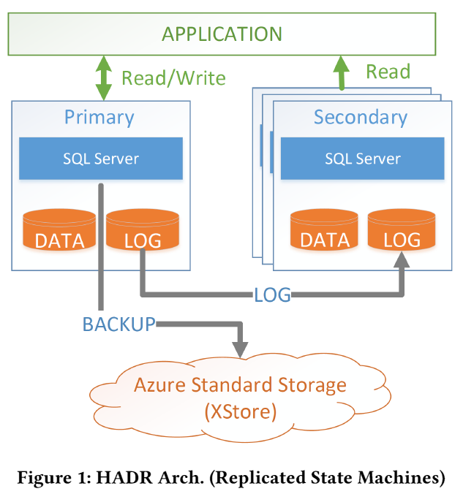
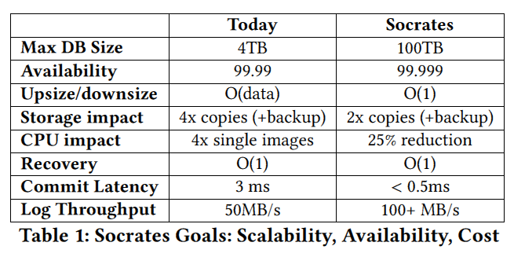
Microsoft Azure: SQL DB HADR Architecture
Single R/W primary
Log shipping with 3 read-only secondaries
Log, incremental/full DB backups
Versioning for snapshot isolation done locally in temporary storage
Resilient buffer pool extension (RBPX)
Source: https://bit.ly/3LYvy50, Microsoft

Slide 52
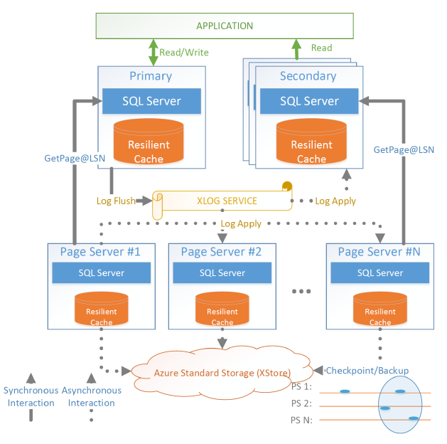
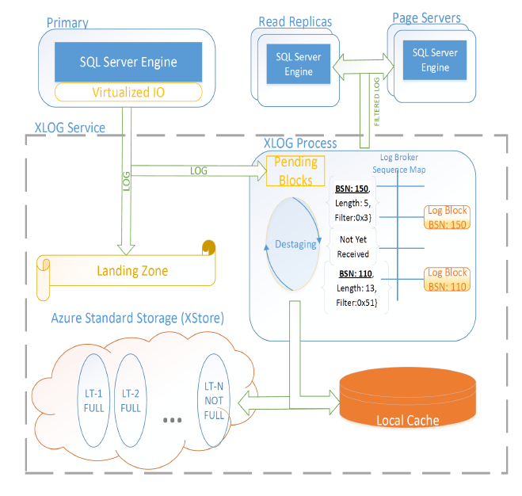
Microsoft Socrates (aka SQL DB Hyperscale)

Slide 53
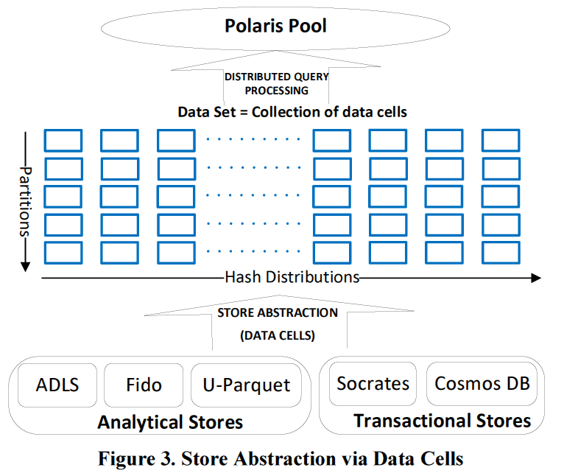
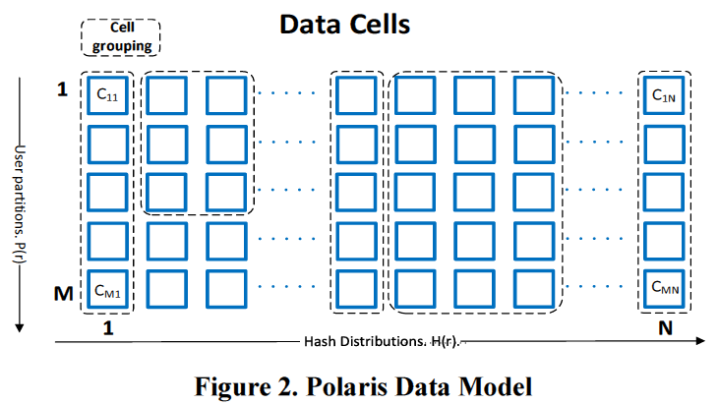
POLARIS: Distributed SQL in Azure Synapse
Converging warehouses and data lakes in Azure Synapse

Slide 54

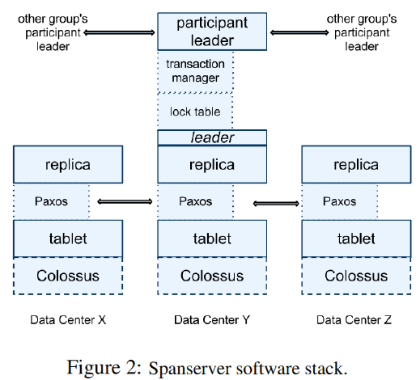
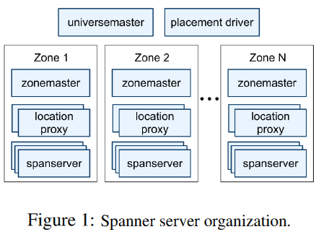
Google Spanner
Globally distributed semi-relational system, SQL-based query lang
Uses Colossus File System (successor to GFS)
Transactional, relies on TrueTime and Paxos

Slide 55
Google F1
Developed for use with AdWords platform replacing MySQL
Relies on Google Spanner; mostly stateless F1 servers
Distributed SQL queries for OLAP-style queries, using snapshot transactions and 2PC
Optimistic concurrency control
Transaction consistent secondary indexes
Protocol Buffer as column data type
Clustered hierarchical tables
Increased read, write and commit latencies
5 copy replication
Row or sub-row level locking
Many issues found with inefficiencies of MySQL ORM layer – replaced with F1 ORM
Multiple client consumers of a single query’s results

Slide 56
CockroachDB (CRDB)
Supports public and private cloud nodes in a single CRDB cluster
Uses standard clock synchronization protocol like NTP
Geo-distributed (range) partitioning and replica placement
At least 3 replicas of every partition
Distributed SQL optimization and execution
Shared nothing architecture
Serializability only – no snapshot isolation! For read-only “follower read” option exists.
PostgreSQL
Store and index Spatial data types with familiar, PostGIS-compatible SQL syntax
Uses Raft consensus protocol
New in v20.2: By default, CRDB uses Pebble storage engine, with RocksDB as an option. Pebble is intended to be bidirectionally compatible with RocksDB on-disk format, but differs in that it:
  Is written in Go and implements a subset of RocksDB's large feature set
  Contains optimizations that benefit CockroachDB

Slide 57
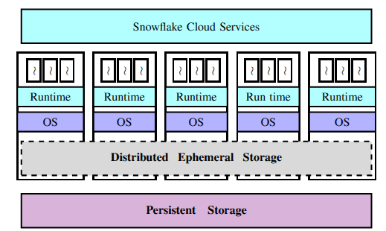
Snowflake
Cloud-based warehouse system
Compute and storage elasticity
Multi-tenancy
Custom-designed storage for management and exchange of ephemeral data as well as for caching persistent data for write-through
Virtual Waterhouse (VW) = set of EC2 instances
Elasticity on fine-grained timescales via pre-warmed VWs
Anonymized 70 million queries available at https://github.com/resource-disaggregation/snowset
Source: https://bit.ly/3eNUXQd

Slide 58
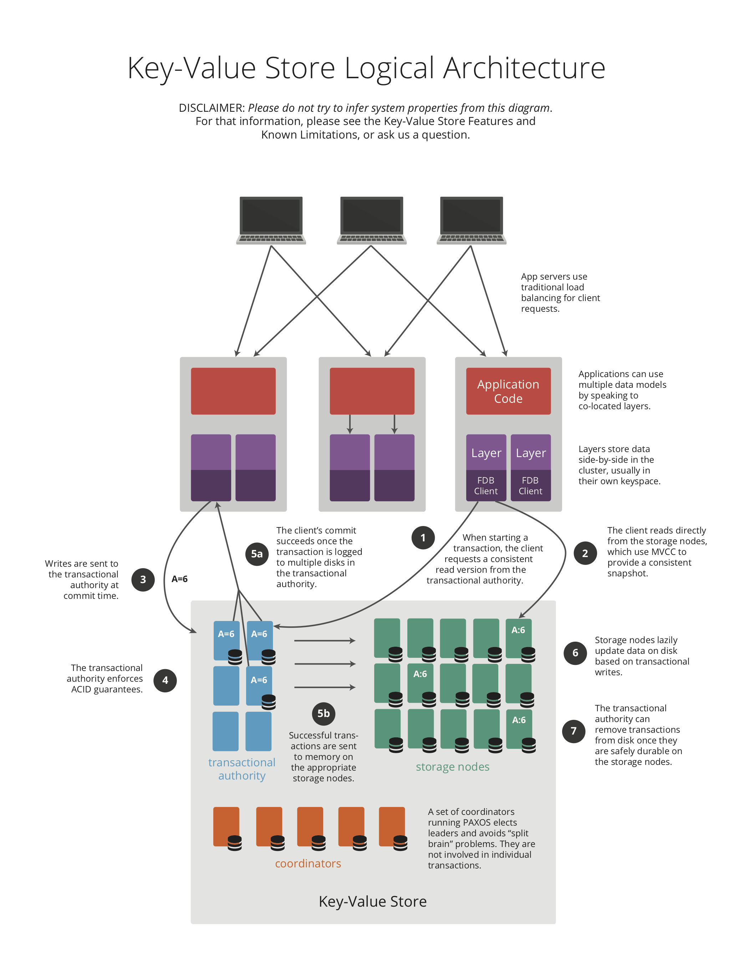
FoundationDB

Slide 59
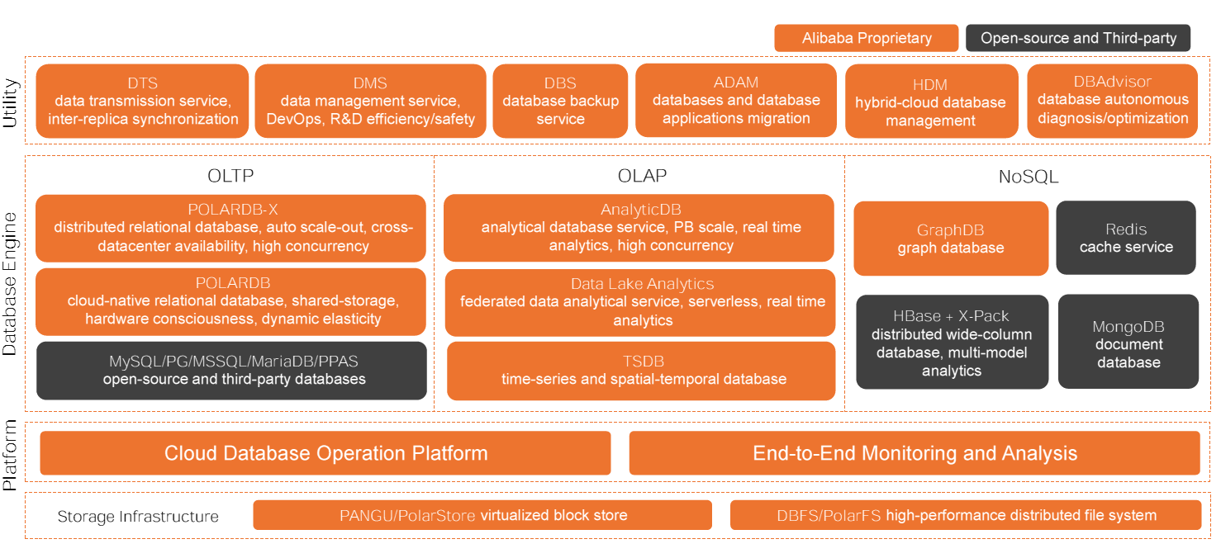
Alibaba Cloud Database Systems

Slide 60
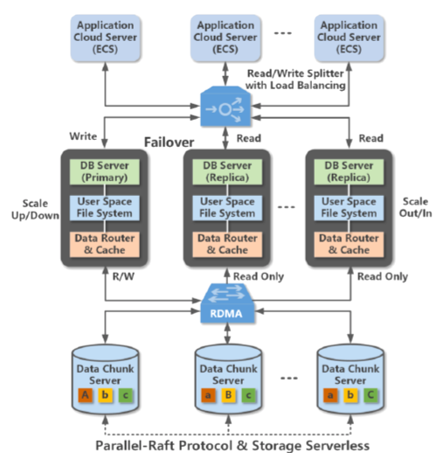
Alibaba POLARDB Architecture
Cloud-native LSM-based row store OLTP system
Compatible with MySQL & PostgreSQL
RDMA interconnect
1 writer & multiple reader nodes
3 copies of data via Parallel-Raft protocol
Built on PolarFS
Pushes down table scans to storage and uses computational storage drives
Source: https://bit.ly/3sZAkZE

Slide 61
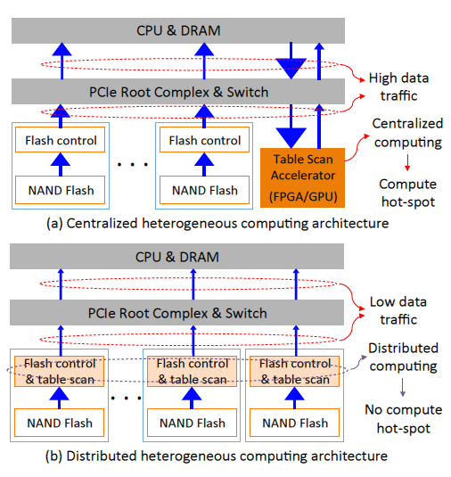
Alibaba POLARDB Architecture
FPGA-based host-managed computational storage drive design
Single FPGA for flash memory control and table scans
Host manages address mapping, request scheduling and garbage collection
PolarFS changed to do table scans
Employs parallelism for scans

Slide 62
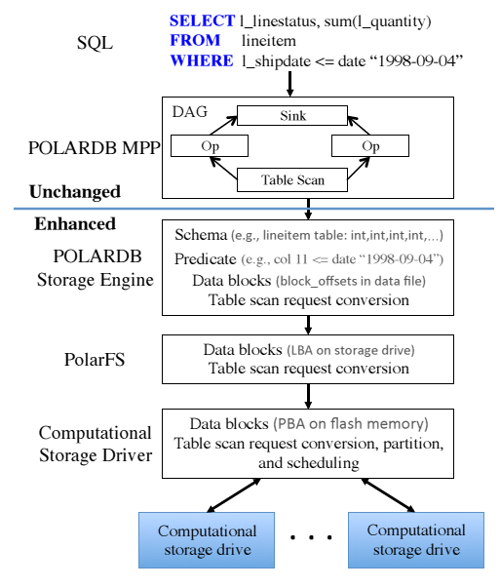
Alibaba POLARDB Architecture
PolarFS changed to do table scans
Employs parallelism for scans

Slide 63
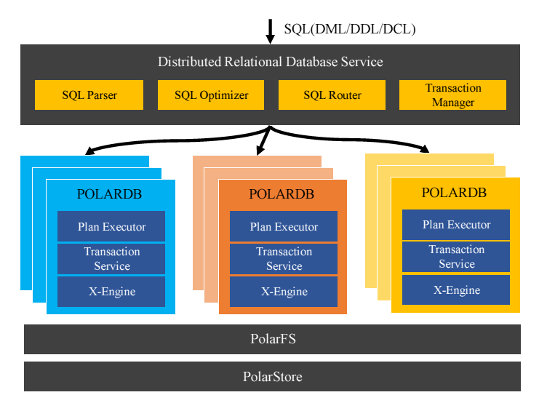
POLARDB-X Architecture
Distributed shared-nothing OLTP DBMS to overcome RDMA-limited scaling
Combines shared-storage and shared-nothing concepts

Slide 64
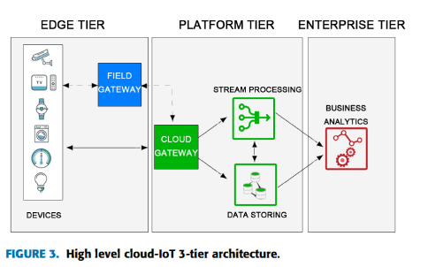
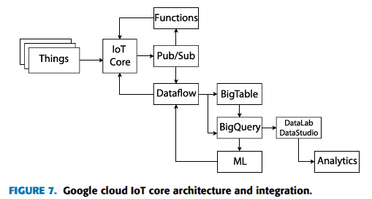
IoT-Cloud Architecture
Source: P. Pierleoni et al. IEEE Access, 2019

Slide 65
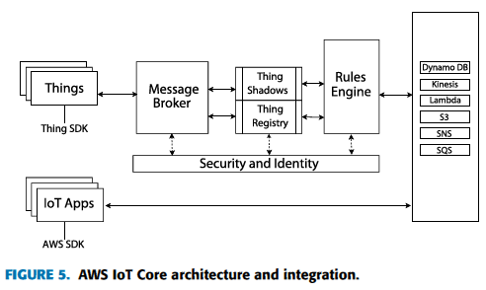
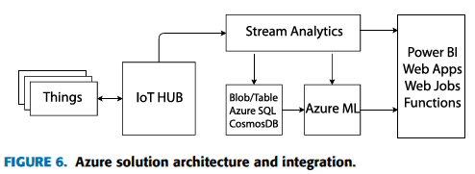
IoT-Cloud Architecture
Source: P. Pierleoni et al. IEEE Access, 2019

Slide 66
Summary
Shared Disks (SD) DBMSs in the on-prem clustered environment have been hugely successful commercially – Oracle and IBM mainframe DB2
Cloud environment brings new DBMS requirements to the forefront
To support multi-master functionality in cloud DBMSs, techniques can be adopted and adapted from what was done in the SD DBMSs
Request to researchers and practitioners to study the papers on SD DBMSs
Slides: https://bit.ly/KLsmPP
Video: https://bit.ly/SMDBvi

